Slide 1
Interested in Studying Sustainability?
Complement your major with an Interdisciplinary Minor in Sustainability
asp.mcmaster.ca

Slide 2
Interdisciplinary Minor in Sustainability
What you’ll gain:
An interdisciplinary perspective on sustainability
Greater access to sustainability courses outside of your Faculty
Access to networking opportunities, sustainability resources, and career support

Slide 3
Interdisciplinary Minor in Sustainability
Requirements:
24 units total
No more than 6 units from Level 1 courses
3 units of SUSTAIN Courses
Sustain 1S03, 2S03, 3S03, 4S06
21 units from the Course List
Selected from two or more Faculties

Slide 4
Thinking about the Minor?
Review the course list
There are more than 90 courses across all Faculties.
Some course are uniquely available “upon permission of the instructor” to students pursuing the Minor in Sustainability.
Consider applying for course exception
If you have taken a course that you feel would contribute to your Minor in Sustainability, such as an independent study course that focused on a sustainability topic, send us a request to have it counted towards your Minor.
Seek guidance from an academic advisor from your home Faculty
All academic advisors are highly knowledgeable about the Minor in Sustainability. They will help to make sure you satisfy all requirements put in place by the University as well as by your home Faculty, such as number of courses that can be counted towards your major and minor.

Slide 5
Connect with “MacSustain” on Social Media

Slide 6
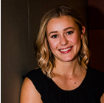
Connect with our Team
Kate Whalen Abbie Little Brent McKnight
Minor Co-Chair Minor Support Minor Co-Chair
whalenk@mcmaster.ca littleaj@mcmaster.ca mcknigba@mcmaster.ca

Slide 7
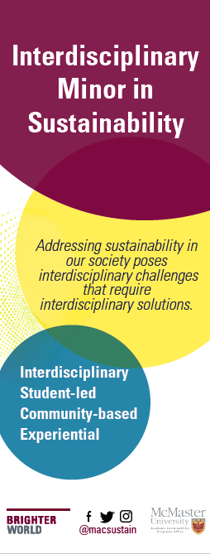
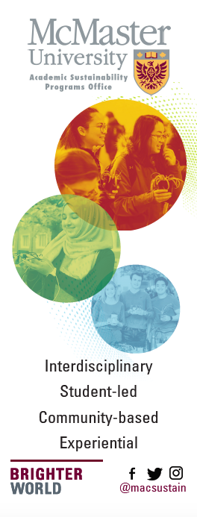

Slide 8
